Slide 1
Traffic Tunes!
Karen Cortez
TIME 2019

Slide 2
An intro to self-efficacy
Me
My cello that was the stress trigger to my shoulder
Self-efficacy: An individual's belief in his or her capacity to execute behaviors necessary to complete specific tasks (Bandura, 1977).
PS Check us out facebook.com/quartedquartet
The shoulder that caused multiple existential crises before realizing I was a musician of worth outside of my instrument
Notes:
So to contexualise this project I wanted to tell you a bit about myself and where I’ve come from on this journey to Traffic Tunes.
I’m a cellist, and during my time at the con I had the displeasure of experiencing the world-upending chaos that is a playing-related injury. There were times that I felt like my injury was proof I couldn’t be a performer, times that I felt like my body was not the right shape to be a cellists’, and times where I felt that making excuses for my failure was proof of a weakness of character. I listened to my cellist peers around me grow stronger and more musical by the day, and instead of being inspired, I began to think, “I’m not like them. I could never be like that”. This is the power of self-efficacy: your belief in your ability to complete a given task.
My Quartet and I have witnessed the power of self-efficacy throughout our tours in regional NSW. Just last week we presented 19 programs in 5 days to a heck of a lot of schools, and before or after our performances we sometimes get the chance to chat with the teachers. Everyone is appreciative of what we bring and tell us how much the kids love what we do. But over time we’ve noticed some key phrases that demonstrate these teachers’ self-efficacy in music

Slide 3
“Talk to X, she's the musical one”
“Our school doesn’t have any music”
Low Self-efficacy in Music
"You just do anything, they'll love it"
Notes:
“Our kids could never do something like that!”
“You’re so talented!”
“They never get anything like that here!”
These comments are just a few that key us into the low musical self-efficacy our primary teachers have in music. How can we have musical children and musical communities if their role models don’t feel like they are musical?

Slide 4
The primary teachers’ musical world
82% of surveyed AUS pre-service teachers believed they lacked personal musical experiences, and considered it a barrier to teaching music in their future classrooms (Russell-Bowie, 2009).
37% AUS primary teachers teaching music regularly (de Vries, 2017)
Less musically confident teachers compounds challenges to teaching music in AUS primary schools
Professional Development run by professional artists or by specialist teachers are not effective: “someone like us” (Snook & Buck, 2014, p. 22)
Notes:
It’s not their fault, really. Teachers are incredibly time poor: they are doused in paperwork and spend over half the year on literacy/numeracy. A perceived difficulty of developing musical skills, compounded with music only being allocated 2% of the year’s teaching time makes professional development in music very unattractive to teachers and school leaders.
In any case, in the same way that I was uninspired by my cello performance peers because I perceived an uncontrollable difference between myself and them, teachers are feeling disconnected to the deliverers of Musical Professional Development, because they perceive too much of a difference between themselves and the PD-giver.

Slide 5
Two issues:
Teachers are time-poor
Professional Development is not being delivered by “someone like us”
Notes:
So I felt like it boiled down to two big issues. Teachers are very time-poor, and don’t feel like the PD is applicable to them.

Slide 6
Enter: Traffic Tunes Let’s get teachers singing!
Teachers are time-poor | Capitalise on driving time (time which cannot be spent marking papers or lesson planning) Simple tune that can be taught in class Track is structured to be useful on multiple listenings
Professional Development is not being delivered by “someone like us” | Untrained singer voice Single-octave range Very little technical music language Rounds remove the barrier of requiring accompaniment
Notes:
Enter, traffic tunes!
For my Tech project, I’ve developed a set of singing resources for primary teachers that they can put on as they drive to work. Driving is a time where you shouldn’t be doing administrative work or marking homework, so it’s a great time to sneak in some music PD. The car is also often a safe place to sing – much like a shower, except dry and with wheels and ideally, clothes.
The songs I have chosen are easy children’s tunes with non-remarkable lyrics so that they can be taught to children, I’ve chosen songs that stay within the range of an octave so that if a teacher teaches this song without a starting note they are less likely to run into any issues, either with themselves or with their students’ singing ranges.
To try and remove the sense that a “musical expert” is delivering PD I’ve chosen to use my own voice as the instructional singer to copy, because many people have insecurities about the quality of their singing voice and often use it as proof of their unmusicality. By using an untrained voice I hope to make myself sound more like a peer. I have also tried to remove things like musical jargon and accompaniment as much as possible so that my teaching on the recording can also be a teaching model for the teacher when they teach the song to their students.

Slide 7
Round in 4 parts
Lyrics C&R (unpitched)
Pitched C&R
Whole melody: 1 part + hummed 2nd entry
Introduction to song
Learn the lyrics
Add the melody
Sing along with the melody
Revise melody, try to sing with another entry
Sing phrases unassisted
Revise
Sing with hummed 2nd entry or attempt own entry
Notes:
I’ve structured the tracks in a way that challenges listeners of different levels, without having advanced learners want to skip ahead a few seconds – remember, we’re driving!
On the first listen, the learner is introduced to the song, its lyrics and melody, and then gets a chance to sing it all the way through. Slower listeners might want to repeat this process a couple of times, and the lyrics section won’t get too boring as a quiet hum outlining the pitch is audible under the lyrics as they are spoken. It’s at a volume that learners who want it can turn it up but those who don’t can have it off.
A second tier of learning is possible on the very same track. The introduction doubles as a way of learning where the round entries go, the lyric learning section provides an opportunity to sing alone to test independence, and the pitched section after gives a chance to revise if that independence testing didn’t go so well. Then the last section is for attempting an entry either with the humming prompt, or entirely on your own, on the 3rd or 4th entries.

Slide 8
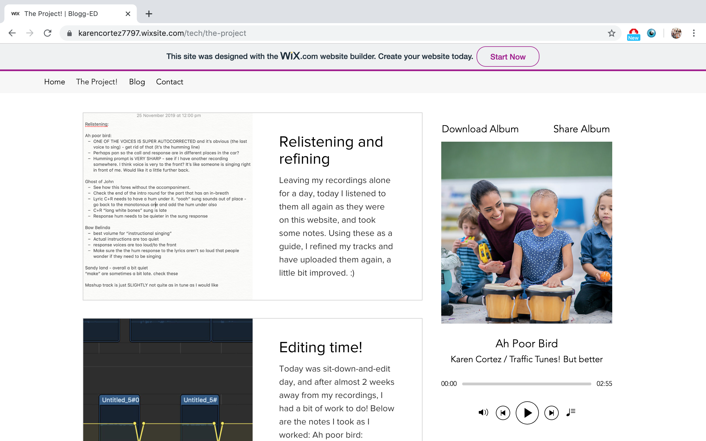
Notes:
For the purposes of this project I have created 5 different tracks, all available for free download on my blog. I have created a track for a round without words, a round with words, a pair of partner songs and a track for practicing singing the partner songs against each other using the stereo capabilities of the car to simulate singing against others.

Slide 9
Tada!
Bandura, A. (1977). Self-efficacy: Toward a unifying theory of behavioral change. Psychological Review, 84, 191-215.
de Vries, P. (2017). Self-efficacy and music teaching: Five narratives. International Journal of Education & the Arts, 18(4). Retrieved from http://www.ijea.org/v18n4/.
Snook, B., & Buck, R. (2014). Artists in schools: “kick starting” or “kicking out” dance from New Zealand classrooms. Journal of Dance Education, 14(1), 18–26.
Russell-Bowie, D. (2009). What me? Teach music to my primary class? Challenges to teaching music in primary schools in five countries. Music Education Research, 11(1), 23-36. DOI: 10.1080/14613800802699549
Notes:
Aaaaand that’s it
Yay

